Slide 1
HsSurvey Update
Camille Mosley

Slide 2
Meeting Agenda
Research questions
Predictions
Data analysis
Next steps/suggestions

Slide 3
Threat to fisheries: Hyperstability
Hyperstability occurs when catch per unit effort (CPUE) remains high while fish density is declining
May be attributed to several factors such as angler skill, behavioral aggregation, and interactions between fish behavior and angler effort density
Hillary G.M. Ward, Paul J. Askey, and John R. Post (2013)
Notes:
Anglers,!!!Normal CPUE expected to be linear function of fish density and anglers would move from lower density lakes as CPUE decreased, giving the chance for the fish pop to rebound/recover self sustaining view of freshwater fisheries, CPUE is equal to C/E

Slide 4
Hyperstability Survey
Questions
How does hyperstability (beta) vary between fish species?
How does building density affect hyperstability?
How do lake characteristics affect hyperstability?
Predictions
Hyperstability varies between fish species
Building density decreases hyperstability
Lake characteristics such as size and depth will vary levels of hyperstability

Slide 5
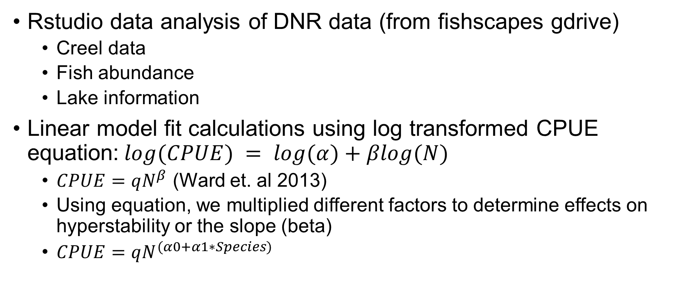
Methods
Rstudio data analysis of DNR data (from fishscapes gdrive)
Creel data
Fish abundance
Lake information
Linear model fit calculations using log transformed CPUE equation:$log(CPUE) = log(α)+βlog(N)$
$CPUE=qN^{β}$ (Ward et. al 2013)
Using equation, we multiplied different factors to determine effects on hyperstability or the slope (beta)
$CPUE=qN^{(α0+α1∗Species)}$
Notes:
We fit the regression using log transformed data Y = b + m1x +m2Fx
${\log\left(CPUE\right)=β}_{0 }+ β_{1}∙log⁡(efCPUE)+ β_{2}∙species∙log⁡(efCPUE)$

Slide 6
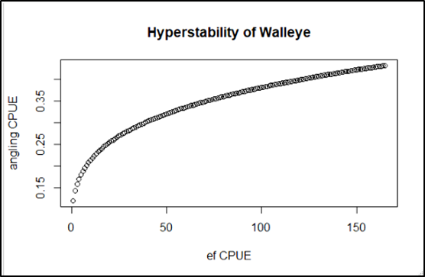
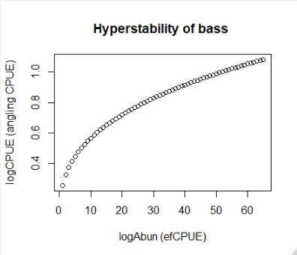
Results
Hyperstability is present in Bass, Walleye, and Panfish populations and is different between species
Significant differences between the hyperstability of largemouth and smallmouth bass, largemouth bass and walleye, and largemouth bass and bluegill populations

Slide 7
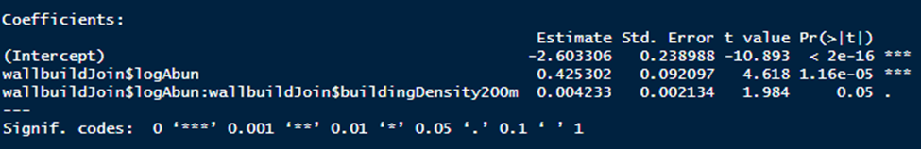
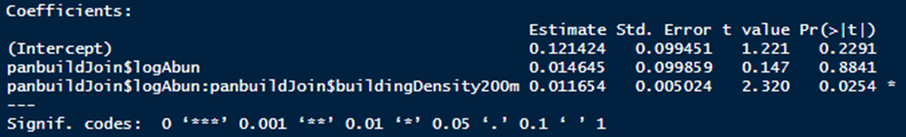
Results
Building density has a small significant effect on the hyperstability of walleye and panfish populations. *Not detected in bass
May be a better metric than CWH density for looking at habitat level effects on hyperstability
Relationship between building density and panfish abundance in Vilas County
Relationship between building density and walleye abundance in Vilas County

Slide 8
Results
Did not detect differences in hyperstability due to lake characteristics measured by DNR (size, depth, lake type,etc.)
No significant difference in hyperstability due to amount of CWH
Currently using Jake Ziegler data from YOY mortality study small # of obs.
Did not detect hyperstability when analyzing Fishscapes 2018-19 PE data

Slide 9
Broader Impacts
Determining which species may need to be prioritized in management strategies by comparing hyperstability magnitude/beta values
Knowing what lake characteristics are significantly impacting hyperstability may help managers optimize certain landscape habitat preservation strategies
Can use information to inform population models to better predict and/or display hyperstability in fisheries

Slide 10
Next Steps
Wrap up data analysis
Census of data
Get more CWH and/or building density data for WI
Small paper

Slide 11
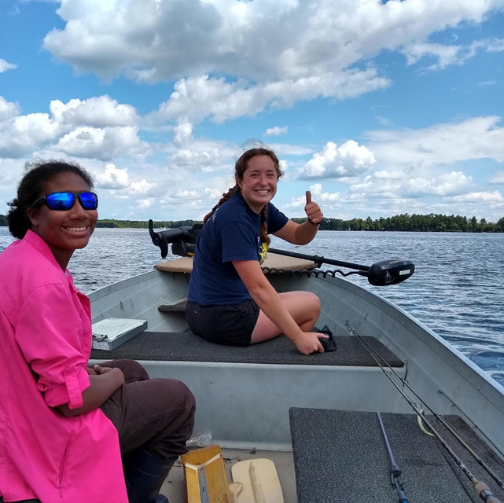
Thanks! Questions?
References
Christensen, David L., et al. “Impacts of Lakeshore Residential Development on Coarse Woody Debris in North Temperate Lakes.” Ecological Applications, vol. 6, no. 4, 1996, pp. 1143–1149., doi:10.2307/2269598.
Dassow, Colin J., et al. “Experimental Demonstration of Catch Hyperstability from Habitat Aggregation, Not Effort Sorting, in a Recreational Fishery.” Canadian Journal of Fisheries and Aquatic Sciences, 2019, pp. 1–8., doi:10.1139/cjfas-2019-0245.
Sass, G. G., et al. “Whole‐Lake Influences of Littoral Structural Complexity and Prey Body Morphology on Fish Predator–Prey Interactions.” Wiley Online Library, John Wiley & Sons, Ltd, 7 Aug. 2006, www.onlinelibrary.wiley.com/doi/full/10.1111/j.1600-0633.2006.00158.x.
Ward, Hillary G.m., et al. “A Mechanistic Understanding of Hyperstability in Catch per Unit Effort and Density-Dependent Catchability in a Multistock Recreational Fishery.” Canadian Journal of Fisheries and Aquatic Sciences, vol. 70, no. 10, 2013, pp. 1542–1550., doi:10.1139/cjfas-2013-0264.
Ziegler, Jacob P., et al. “Coarse Woody Habitat Does Not Predict Largemouth Bass Young of Year Mortality during the Open-Water Season.” Canadian Journal of Fisheries and Aquatic Sciences, vol. 76, no. 6, 2019, pp. 998–1005., doi:10.1139/cjfas-2018-0050.

Slide 12
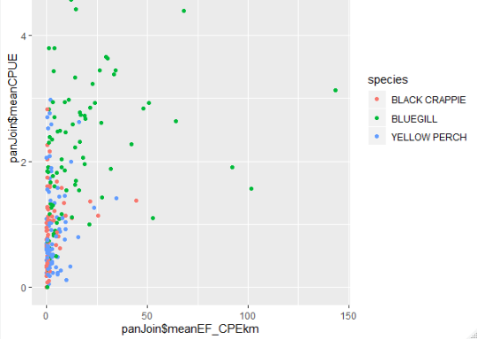
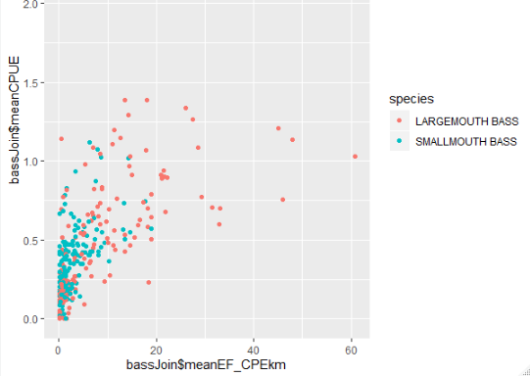
Hyperstability for lake-year observations across panfish and bass species

Slide 13
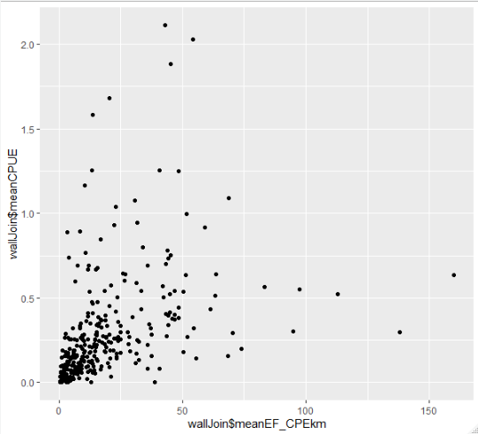
Hyperstability of walleye lake-year observations

Slide 14
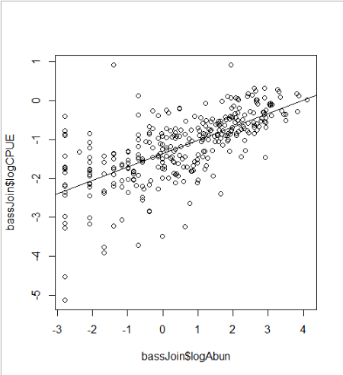
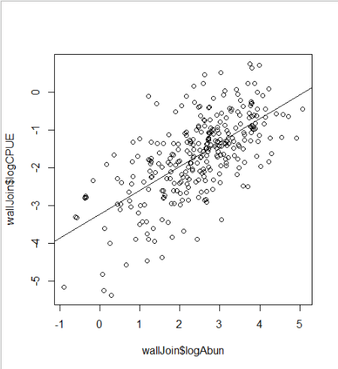
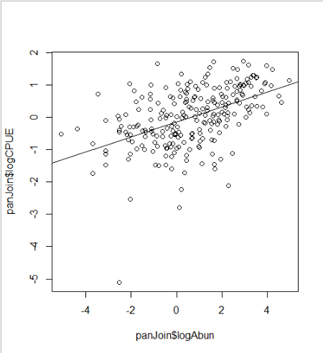
Plots of log transformed hyperstability with model fits

Slide 15
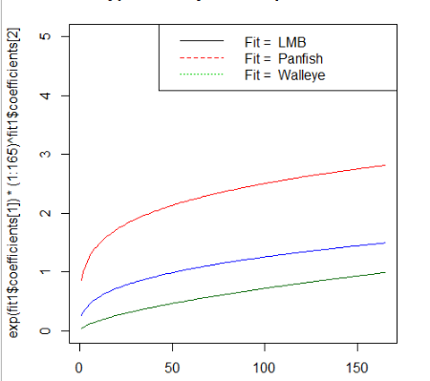
Model fits plotted together

Slide 16
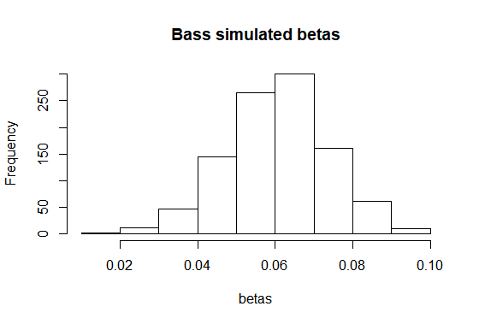
Beta bootstrapping for bass data

